Slide 1
Subject Name : Programming in C Presentation Title: Data types in C
JEPPIAAR INSTITUTE OF TECHNOLOGY
“Self-Belief | Self Discipline | Self Respect”
Department of Computer Science and Engineering
Team Members:
Students Name Reg.No:
1. M. Sanjai 210619104043
2. A. Santhosh 210619104044
3. S. Santhosh 210619104045
4. N. Saran 210619104046

Slide 2
WHAT IS C ?
C is the general propose computer programming language developed in 1972 by Dennis Ritchie at the Bell Telephone Technologies . It was C because many of its features were derived from an earlier language called ‘B”.
Like many other language , C is derived from ALGOL(the first language to use a block structure).Although ALGOL was not accepted widely in US but it was widely used in Europe.
C is being used on several different software platforms . C language has been so widely accepted by profesionals that compilers ,libraries and interpreters.

Slide 3
BASIC DATA TYPES IN C :
C language provides a few basic data types .Data types specify how we enter the data into our programs and what type of data we enter
C language has some pre-defined set of data types
to handle various kind of data that we can use in our program. These data types have different storage capacities

Slide 4
TYPES OF DATA TYPES :
PRIMARY DATA TYPES :
These are fundamental data types in C , namely integer(int),floating point(float),character(char), void.
DERIVED DATA TYPES:
Derived data types are nothing but primary data types but little twisted or grouped together like array , structure, union, and pointer.

Slide 6
TABLE :
Data types | Keyword used | Size in bytes | Range | Use
Character | Char | 1 | -128 to 127 | To store characters
Integer | int | 2 | -32768 to 32767 | To store integer number
Floating point | float | 4 | 3.4E-38 to 3.4E+38 | To store floating point numbers
Double | double | 8 | 1.7E-308 to 1.7E+308 | To store big floating point numbers
Valueless | void | 0 | valueless | -

Slide 7
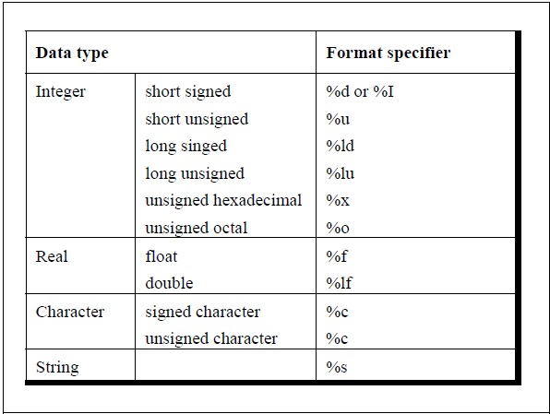

Slide 8
In addition ,C also supports four modifiers –two sign specifiers (signed and unsigned) and two size specifiers(short and long)
we have unsigned char and signed char . Do we have negative characters ? No , then why do we have such data types ? The answer is that we use signed and unsigned char to ensure portability of programs that store non character data as char.

Slide 9
Data Type | Size in bytes | Range
Char | 1 | -128 to 127
Unsigned char | 1 | 0 to 255
Signed char | 1 | -128 to 127
int | 2 | -32768 to 32767
Unsigned int | 2 | 0 to 65535
Signed int | 2 | -32768 to 32767
Short int | 2 | -32768 to 32767
Unsigned short int | 2 | 0 to 65535
Signed short int | 2 | -32768 to 32767
Long int | 4 | -2147483648 to 214748
Unsigned long int | 4 | 0 to 4294967295
Signed long int | 4 | -2147483648 to 214748
float | 4 | 3.4E-38 to 3.4E+38
double | 8 | 1.7E-308 to 1.7E+308
long double | 10 | 3.4E-4932 to 1.1E+4932

Slide 10
While the smaller data types take less memory , the larger types incur a performance penalty. Although the data type we use for our variables does not have big impact on the speed or memory usage.
To specify the return type of function
To specify the parameters of the function.
To create generic pointers . We will read about generic pointers in the chapter on pointers .

Slide 11
How are float and double stored ?
In computer memory , float and double values are stored in mantissa and exponent forms where the exponent represents power of 2 (not 10).
The number of bytes used to represent a floating point number generally depends on the precisions of the value.
While float is used to declare single-precision value double is used to represent double precision value.

Slide 12
Floating-point numbers use the IEEE(Institute of Electrical and Electronics Engineers) format to represent mantissa and exponents .
According to the IEEE format , a floating point value in its binary form is known as normalized form.
In the normalised form , the exponent is adjusted in such a way that a binary point in the mantissa always lies to the right of the most significant non zero digit.

Slide 13
Thank You

